Slide 1
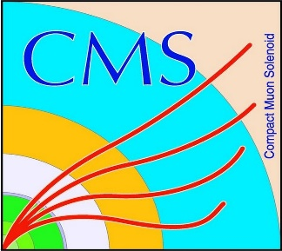

HEP Weekly Report
George Bakas
NTUA

Slide 2
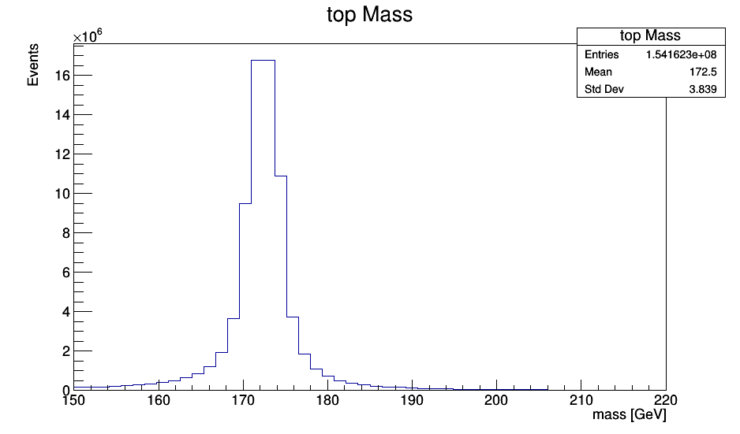
Kinematics

Slide 3
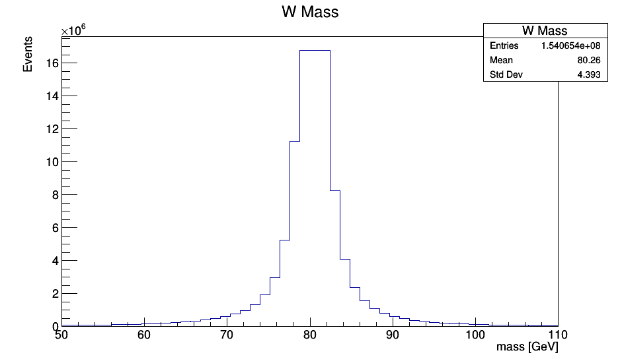
Kinematics

Slide 4
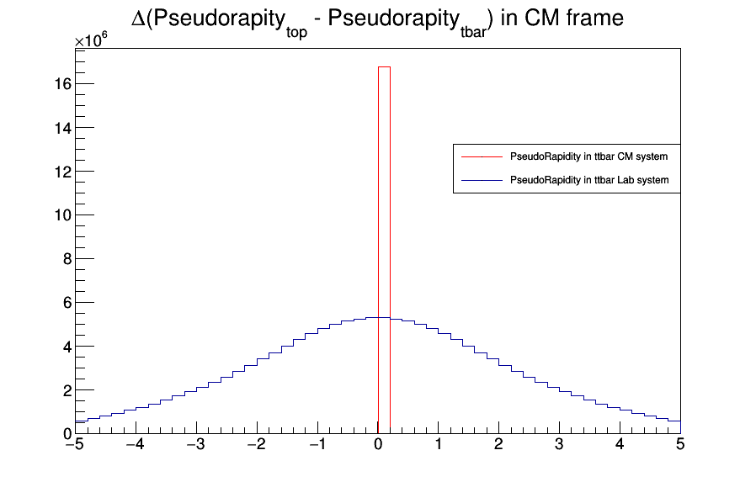
Kinematics This is the Pseudorapidity difference of the top and and the antitop quarks in the CM frame

Slide 5
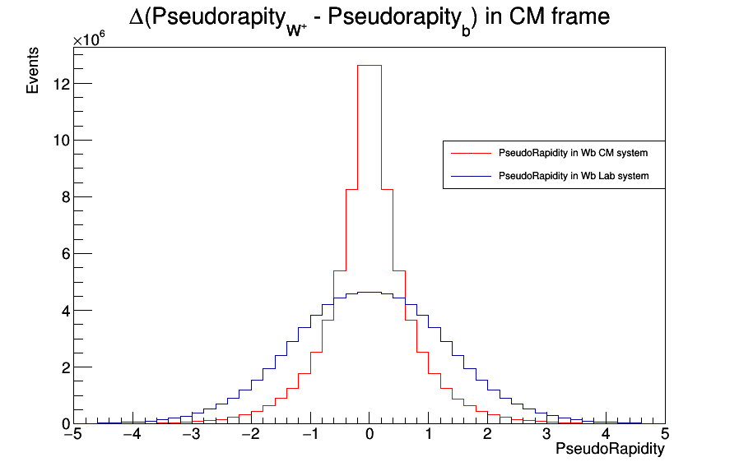
Kinematics This is the Pseudorapidity difference of W⁺ and b quark in the top Rest Frame

Slide 6
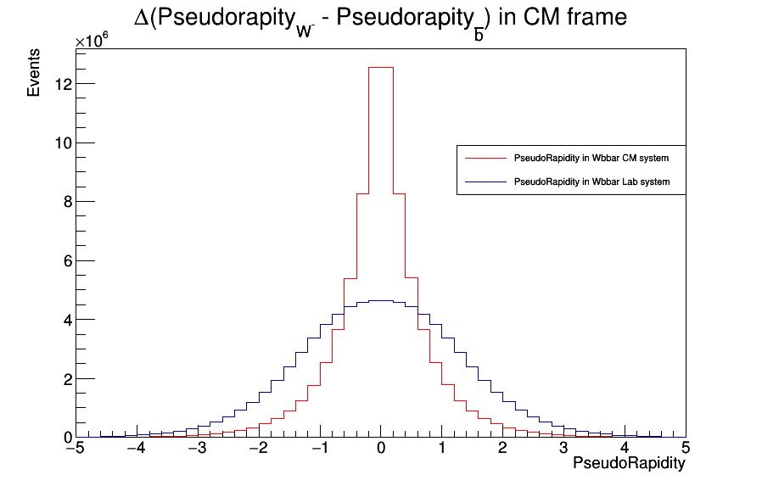
Kinematics This is the Pseudorapidity difference of W⁻ and bbar quark in the anti-top Rest Frame

Slide 7
Kinematics
Total number of events: 77081156
Fully Hadronic: 35187365 (fraction of 45.6% of total events)
Semileptonic: 33716560 (fraction of 43.7% of total events)
Dileptonic: 8080716 (fraction of 10.4% of total events)

Slide 8
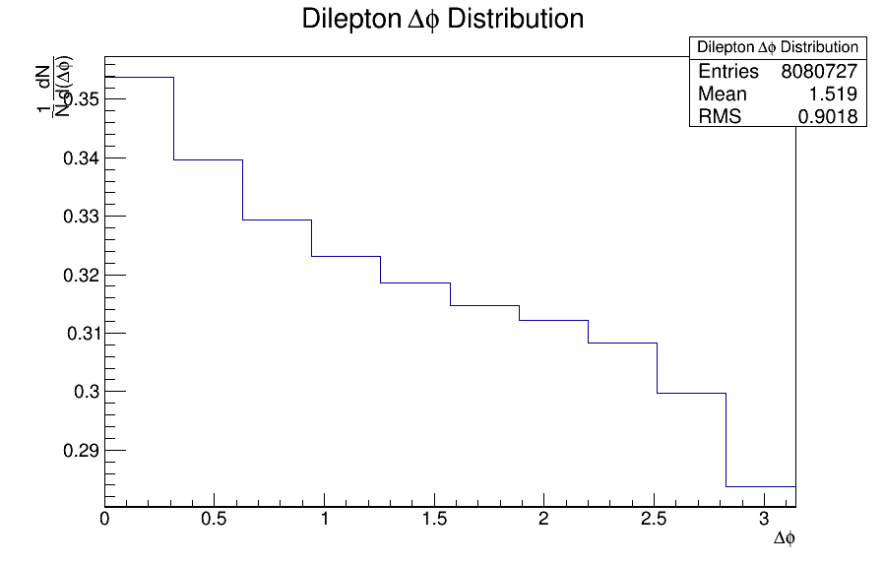
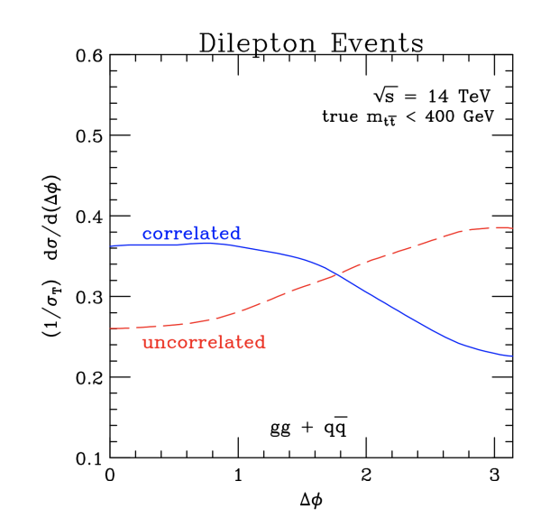
Angular Distributions This is the Δφ distribution from l⁺, l⁻ in Lab frame with no cuts @Parton Level Last bin problem (?) checking again maybe the normalization is not done well

Slide 9
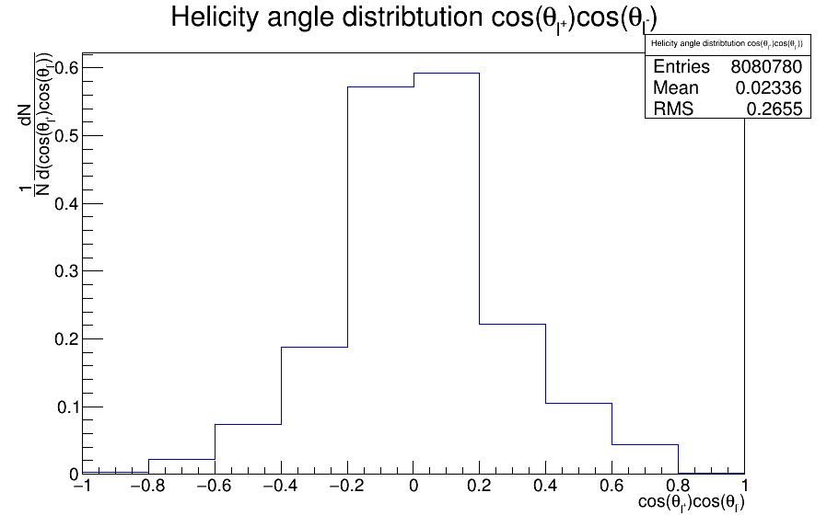
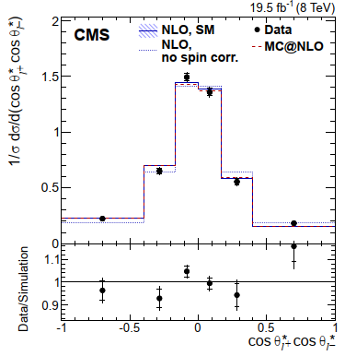
Angular Distributions This is the cos(θ_{helicity}^{l+})cos(θ_{helicity}^{l-}) distribution from l⁺, l⁻ in the W⁺,W⁻ rest frames respectively

Slide 10
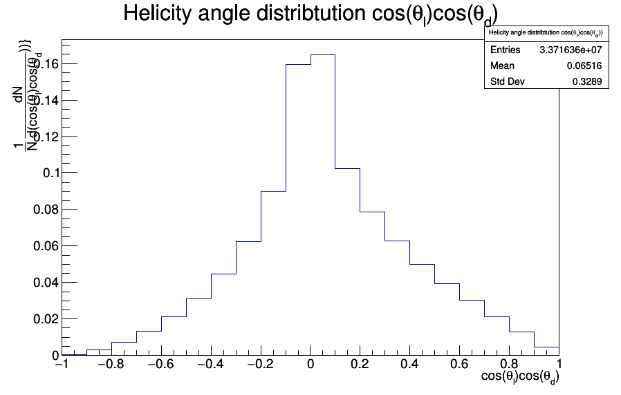
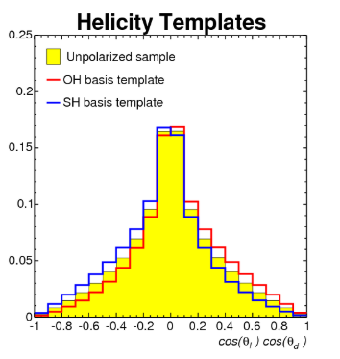
Angular Distributions This is the cos(θ_{helicity}^{l})cos(θ_{helicity}^{d}) distribution from l+, down (or l⁻, dbar) where θ= Helicity angle of lepton or down quark

Slide 11
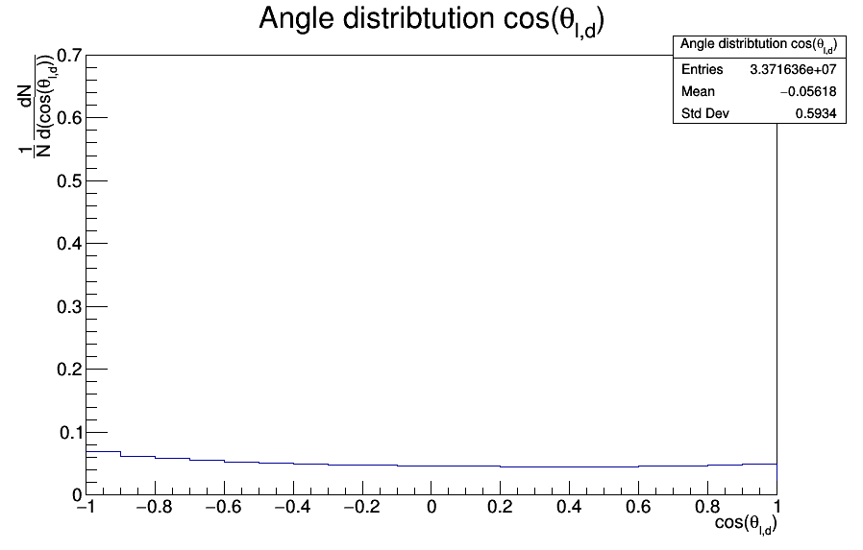
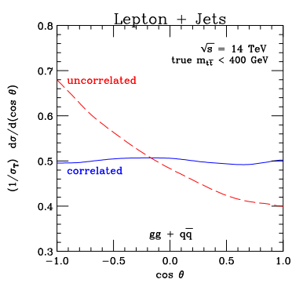
Angular Distributions This is the cos(θ_{lepton,down}) distribution from l+, down (or l⁻, dbar) where θ=opening angle between lepton and down quark in ttbar rest frame (Zero Momentum Rest Frame) I am not sure about this histogram…. I see different shape than the expected

Slide 12
DCS:
fwInstallationUtils components
Testing a modification Giannis made and checking some bugs, etc
CMSfwFsmXml component
Reported bug when importing an already set device type in the project via XML file
Ordered new PCB for ArdEnvino
Probably will have by the end of this week
If this PCB is bug-free will continue with a 3D printed case
The idea is to have this project as a black box with a screen and 1-4 connected sensors

